Slide 1
Bunch compressor design for
FEL @ eRHIC
Yichao Jing and Vladimir Litvinenko
FLS2012, Newport News, VA
3/8/2012

Slide 2
Outline
Introduction of eRHIC and the options for FEL.
ARCs and their effect on beam properties.
C-type Bunch compressor and its limitation.
Two stage bunch compressor with minimized CSR effect.
Possible FEL process and its performance.
Summary.
Yichao Jing
yjing@bnl.gov

Slide 3
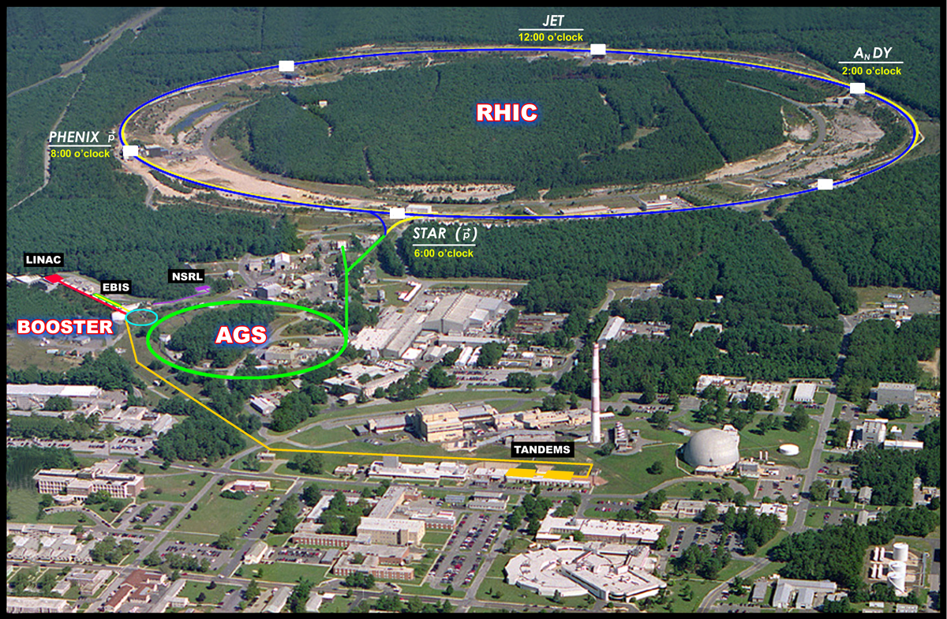
eRHIC : an upgrade of RHIC
Add e- accelerator to the existing $2B RHIC
FLS2012
yjing@bnl.gov

Slide 4
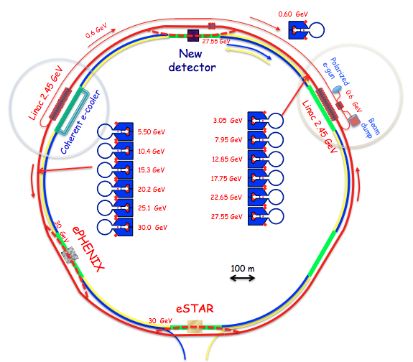
eRHIC layout and e- beam parameter
Energy, GeV | 30
Bunch seperation (ns) | 74
Bunch charge (nC) | 0.5
Beam current (mA) | 12.6
rms bunch length (cm) | 0.2
6 passes ERL with superconducting LINACs
Yichao Jing
yjing@bnl.gov

Slide 5
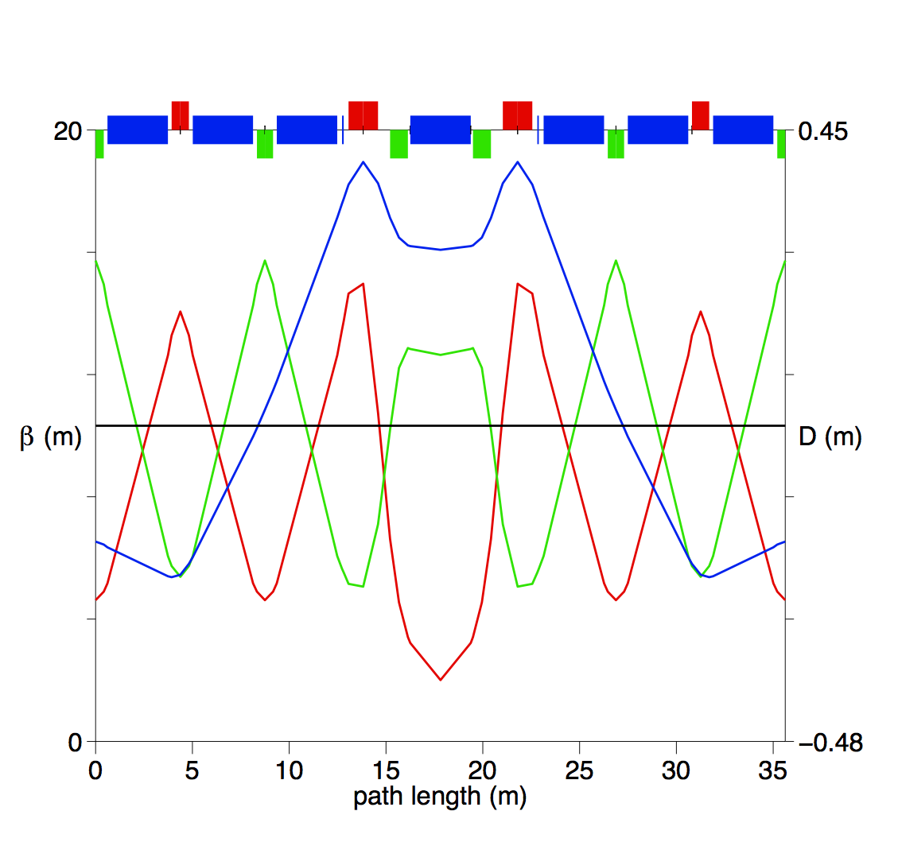
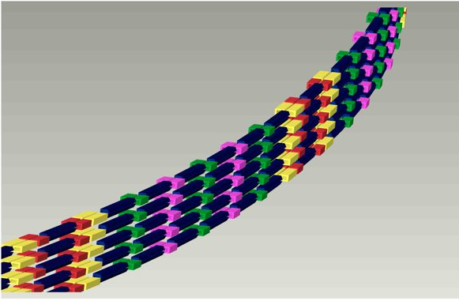
eRHIC ARC design
E_{beam} (GeV) | 30
L_{dip} (m) | 3.12
B₀ (T) | 0.4798
K_{quad}L(T/m) | 28.96
Number of basic cell in each sextant | 10
Courtesy of D. Trbojevic
Dipole and quadrupole strengths are tuned to make the whole sextant achromatic and asynchronous.
Yichao Jing
yjing@bnl.gov

Slide 6
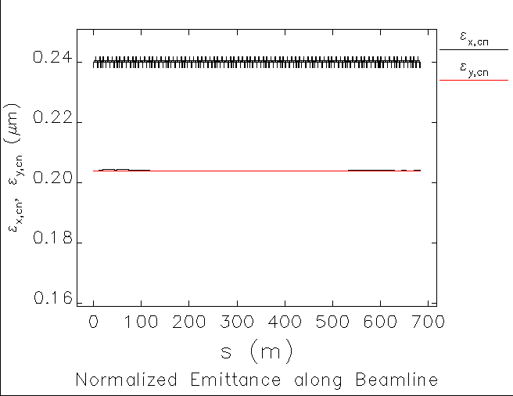
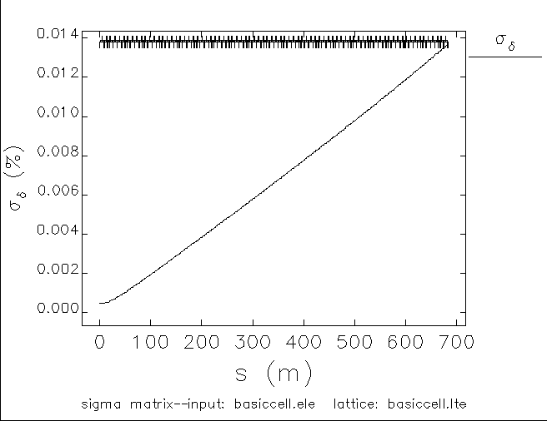
ARC effect on beam emittance
Strong dipole magnets do not blow up beam emittance as long as the bunch charge is low (~0.2 nC).
Both CSR and ISR effects are included in ELEGANT simulation. CSRDRIFTs are used to simulate the effect in drifts.
Yichao Jing
yjing@bnl.gov

Slide 7
Beam parameters for eRHIC FEL
Choose low energy (~ 10 GeV) for FEL to avoid severe blow up in both emittance and energy spread caused by synchrotron radiation. Normalized emittance is largely depend on the injector and assumed to be 0.2 μm in simulation.
Yichao Jing
yjing@bnl.gov

Slide 8
Location of BC for eRHIC FEL mode
BC
Compress the 2nd pass e- beam @ 12 o’clock.
Beam extraction
Use the linac @ 2 o’clock as chirping cavity and the linac @ 10 o’clock as energy spread compensator.
BC at single fixed energy to avoid phase space deterioration in circular passes.
Yichao Jing
yjing@bnl.gov
Notes:
Best BC scheme would be to compress twice at different energy and use long linac for energy spread compensation. Not possible for ERL and long circular passes. Dangerous to expose to all the imperfections (long path) to keep phase space even when R56 =0.

Slide 9
Single stage C-type bunch compressor
e- beam before entering chirping cavity
BC @ 12 o’clock (avoid full rotation)
Chirping cavity @ 2 o’clock
E_{i}(GeV) | 5.5
σ_{i} (mm) | 0.3
Q (nC) | 0.2
δ_{i} | 4.5e-6
Ε_{i} (mm-mrad) | 0.2
Θ_{max} (rad) | 0.23
L_{dip} (m) | 2
L_{drift}1-2 (m) | 6.4
L_{drift}2-3 (m) | 1
E_{rf} (MV/m) | 12.5
ϕ_{i} (deg) | 77.8
Accelerating cavity @ 10 o’clock
E_{rf} (MV/m) | 12.5
ϕ_{i} (deg) | 90.5
Yichao Jing
yjing@bnl.gov
Notes:
Large chirp to reduce chicane strengths. Not to large to keep energy spread low for FEL.

Slide 10
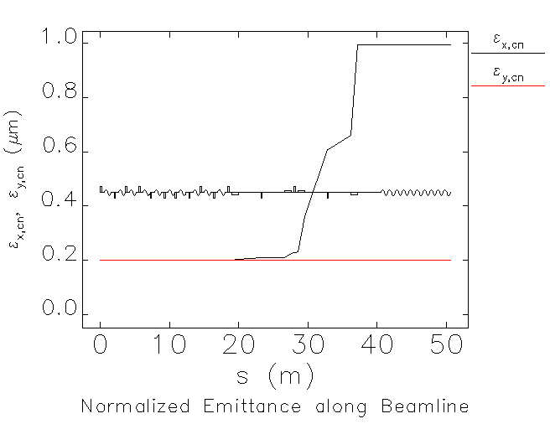
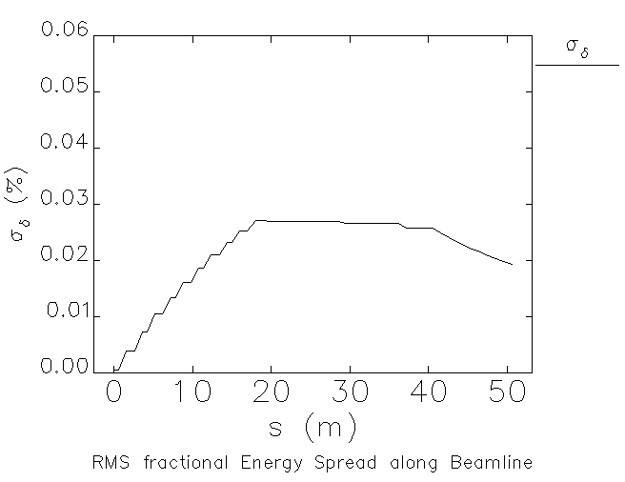
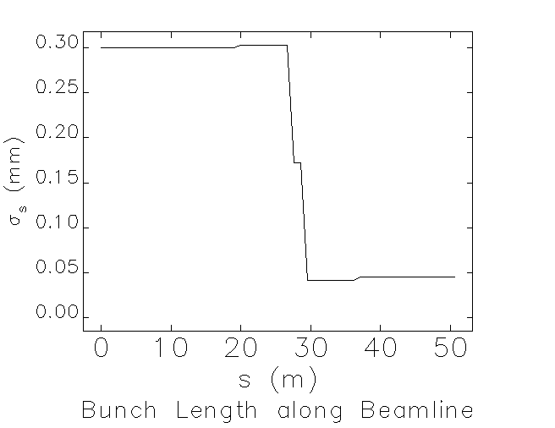
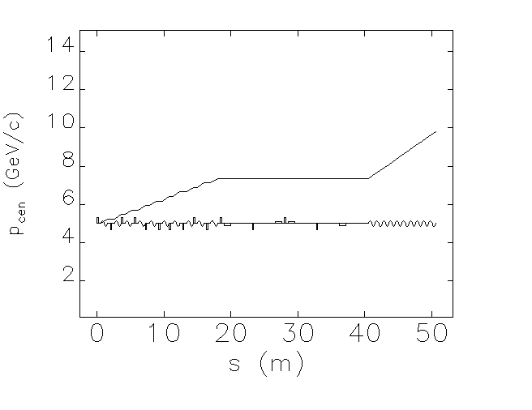
Single stage C-type BC (cont’d)
Emittance blown up 5-fold by CSR.
Some techniques can be employed to minimize CSR but the improvement is small.
How?
Yichao Jing
yjing@bnl.gov
Notes:
such as weakening the last two bends by increasing drift length ; minimizing optics functions?

Slide 11
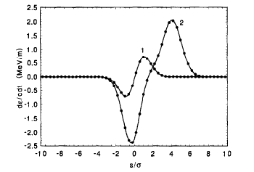
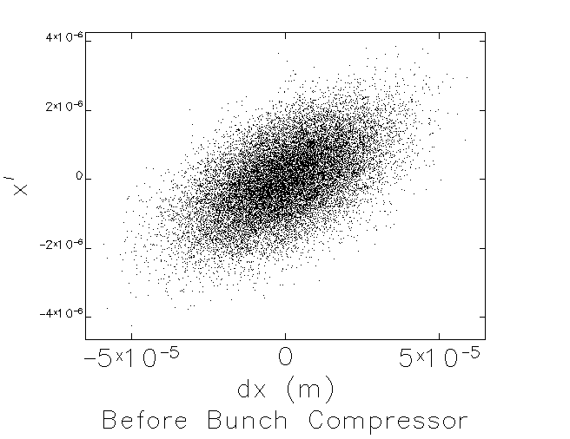
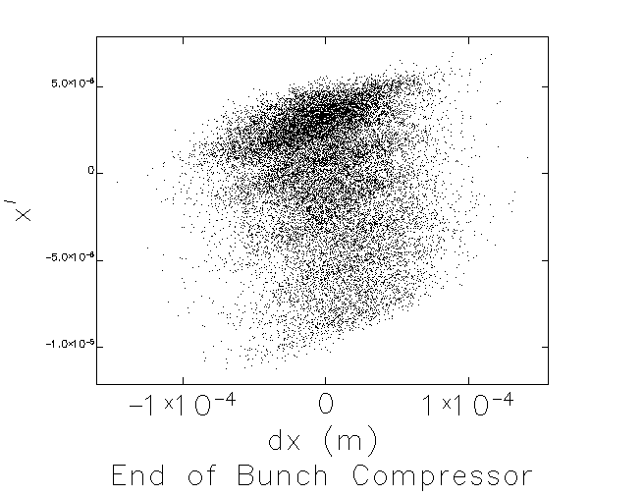
Emittance spoil due to CSR wakes
A typical CSR wake looks like:
CSR wakes change particle energy according to its longitudinal position within a bunch -> induce energy spread.
This results in the change in transverse beam position (x) and divergence (x’) through D and D’.
E.Saldin et. Al. NIMA 398 (1997)
Phase space plots show clear evidence of emittance spoil due to the longitudinal – transverse coupling in chicanes.
Yichao Jing
yjing@bnl.gov

Slide 12
Cure – two chicanes
Using two chicanes with opposite bending directions (thus opposite) D and D’, it is possible to compensate the emittance growth by cancelling the transverse effects induced by CSR wakes.
Change in energy in second chicane is stronger due to stronger wakes – shorter bunch length, thus the bending strength should be smaller.
Beam energy change diagram along the beam line:
head
Phase advance between two chicanes can be tuned to realign different longitudinal slices – reduce the overall projected emittance.
center
1st chicane
tail
2nd chicane
Yichao Jing
yjing@bnl.gov

Slide 13
Modified S-type BC
Scheme of the 2 chicane BC :
C-type chicane 1
Phase shifter
C-type chicane 2
Modified S-type BC
The two C-type chicanes are located at the same energy (7.9 GeV) with opposite bending directions.
By adjusting the phase advance, optics and relative compression strengths of the two chicanes, we wish to maximize the cancellation of the CSR effect.
The total rotation in phase space needs to stay the same. We don’t want to sacrifice the peak current!
Yichao Jing
yjing@bnl.gov

Slide 14
Phase shifter
Phase shifter is done using a matrix element (EMATRIX in ELEGANT) with components as:
Simple model without worrying the detailed magnets and optics. Ideal for parameter scan.
with β, α, ψ the optics functions and phase advance at the first and second chicanes respectively.
Yichao Jing
yjing@bnl.gov

Slide 15
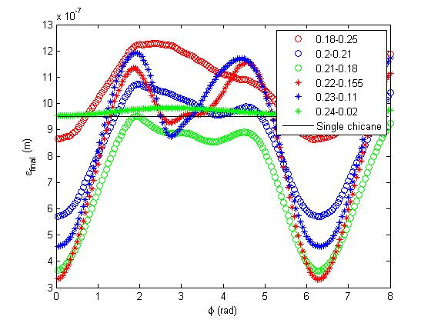
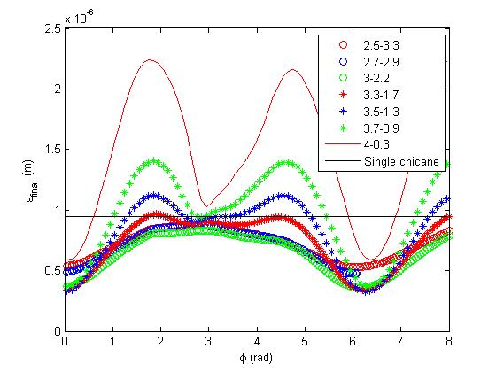
Phase and strengths scan
We scan through the phase advance, the bending angles of the two chicanes and drift lengths between dipoles:
Drifts (3.5 -1.3) are fixed
Angles (0.22 – 0.155) are fixed
Optimal phase advance is 6.05 rad.
Optimal ratio in strengths (R₅₆) of two chicanes is 4:1.
Single chicane’s final emittance is shown as a baseline. Best parameter set reduces the emittance growth to about 60%.
Yichao Jing
yjing@bnl.gov

Slide 16
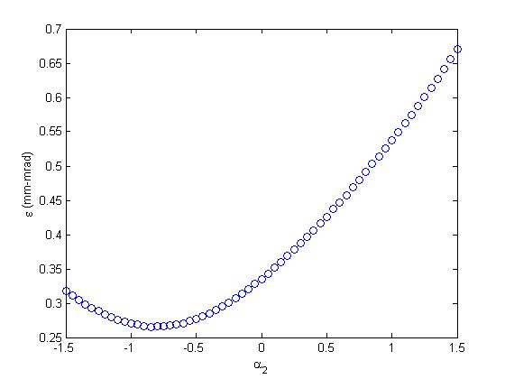
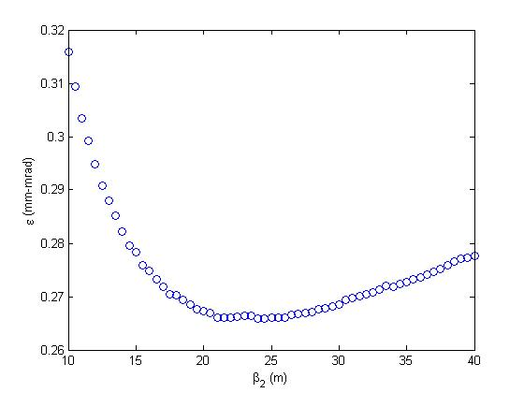
Optics scan
We also scan thru the optics functions (β, α) @ 2nd chicane:
Fix beta, change alpha
Fix alpha, change beta
Alpha function has stronger effect than beta function and the optimal point has a emittance growth of about 30%.
Yichao Jing
yjing@bnl.gov

Slide 17
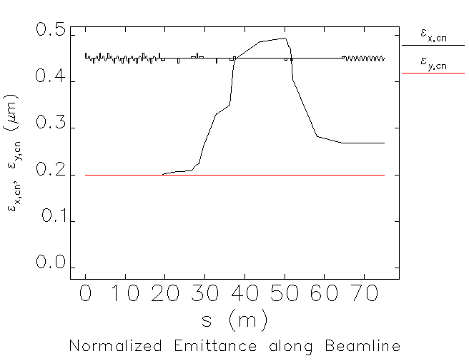
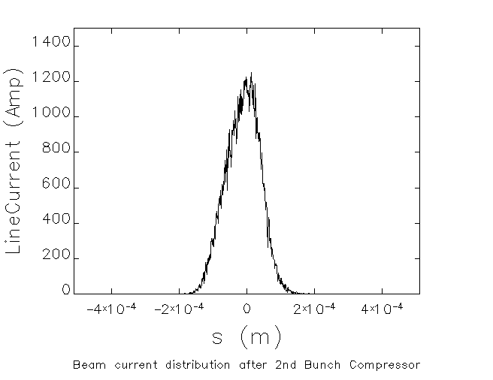
Tracking results
Using the best parameter set, we track 200000 particles assuming Gaussian distribution along the bunching system (CSR, ISR, SR, higher order terms etc. are included, no external wakes considered):
Yichao Jing
yjing@bnl.gov

Slide 18
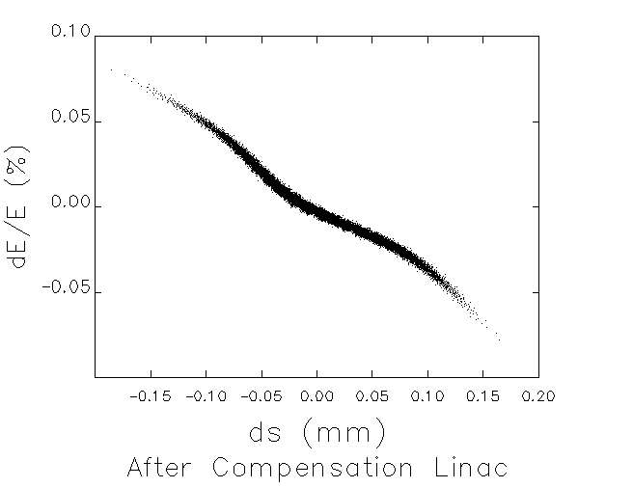
Final distribution and FEL setup
Final beam parameters:
Final longitudinal phase space distribution
E_{f}(GeV) | 9.97
σ_{f} (mm) | 0.01
Q (nC) | 0.2
δ_{f} | 1.91e-4
Ε_{f} (mm-mrad) | 0.26
Undulator setup :
λ_{u} (cm) | 3
K_{w} (T-cm) | 1.2462
λ_{r} (Å) | 1
Yichao Jing
yjing@bnl.gov

Slide 19
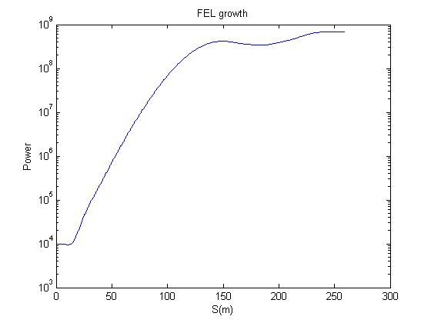
Power growth
Using the final particle distribution from ELEGANT, we simulate the FEL growth in GENESIS :
Reaches saturation in 150 m.
Fitted 3D gain length : 3.1 m.
Yichao Jing
yjing@bnl.gov

Slide 20
Summary
eRHIC is an upgrade project of current RHIC and is working on its way of getting approved by DOE.
eRHIC can provide very high quality e- beam which can be used as a perfect platform for FEL.
We develop a scheme to design a bunch compressor for the beam preparation for FEL with minimized CSR effect. By scanning through the parametric space, we are able to reduce the CSR effect to about 30%, an order of magnitude smaller than a single stage BC @ this energy level.
FEL performance with this e- beam seems promising.
Yichao Jing
yjing@bnl.gov

Slide 21
Backup slides
Yichao Jing
yjing@bnl.gov

Slide 22
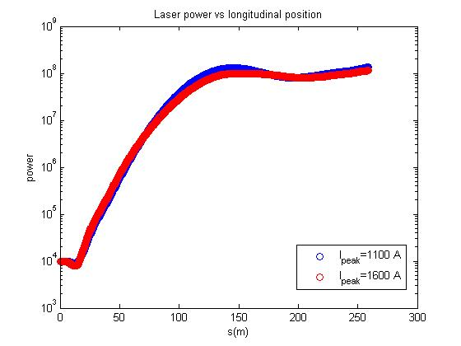
Peak current for FEL
Full rotation would certainly increase the peak current. However, it would also induce a larger correlated energy spread which is hard to compensate downstream. Not to mention the magnified CSR effect. Thus a relative low (~1 kA) beam current is preferable for our implementation.
Yichao Jing
yjing@bnl.gov

Slide 23
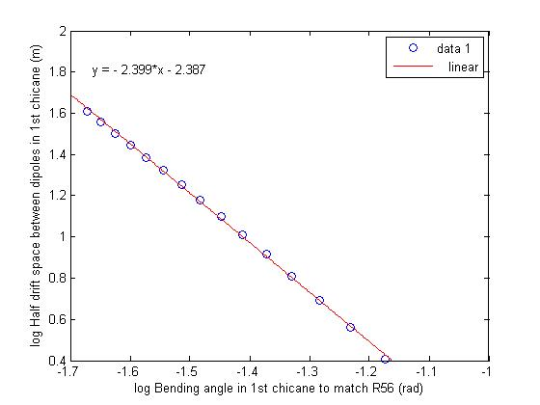
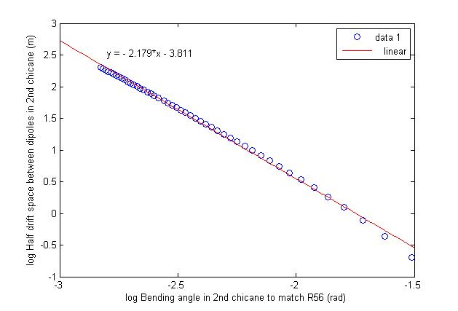
R₅₆ vs bend angle
Under small angle approximation, using trigonometry, we can prove relation
L is the drift length between dipole 1-2 and θ is the bending angle of a dipole. The first term is the path difference in drift space, and second term the path difference in dipoles.
For our case, the small angle is approximation no longer valid thus the result deviates from square relation a bit
Yichao Jing
yjing@bnl.gov

